Slide 1
Membrane Air Separation
Group 3
Adil Feratovic, Hussein Rezk, Aaron Casas, Anna Cai
Chemical Engineering Lab I
09/30/25

Slide 2
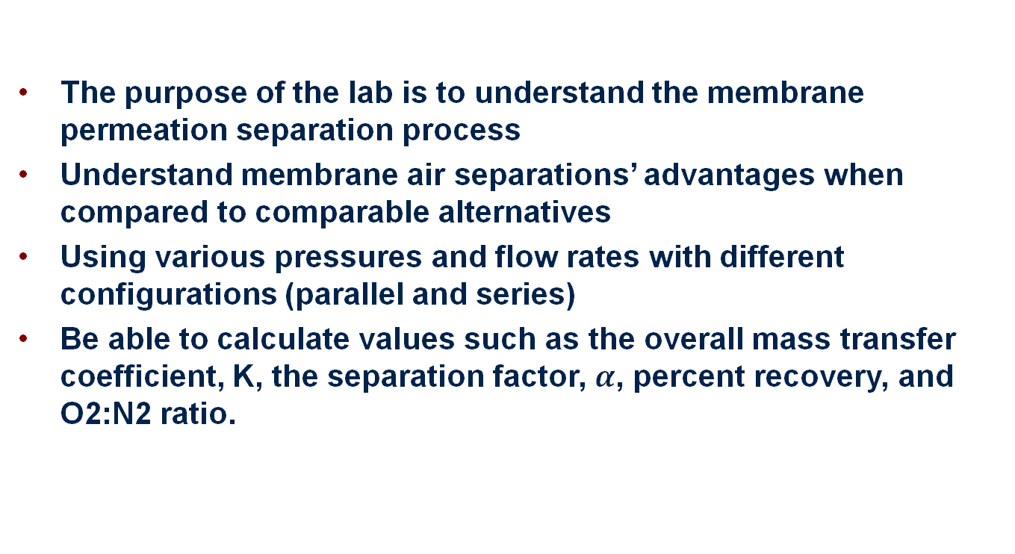
Introduction
The purpose of the lab is to understand the membrane permeation separation process
Understand membrane air separations’ advantages when compared to comparable alternatives
Using various pressures and flow rates with different configurations (parallel and series)
Be able to calculate values such as the overall mass transfer coefficient, K, the separation factor, $α$, percent recovery, and O2:N2 ratio.

Slide 3
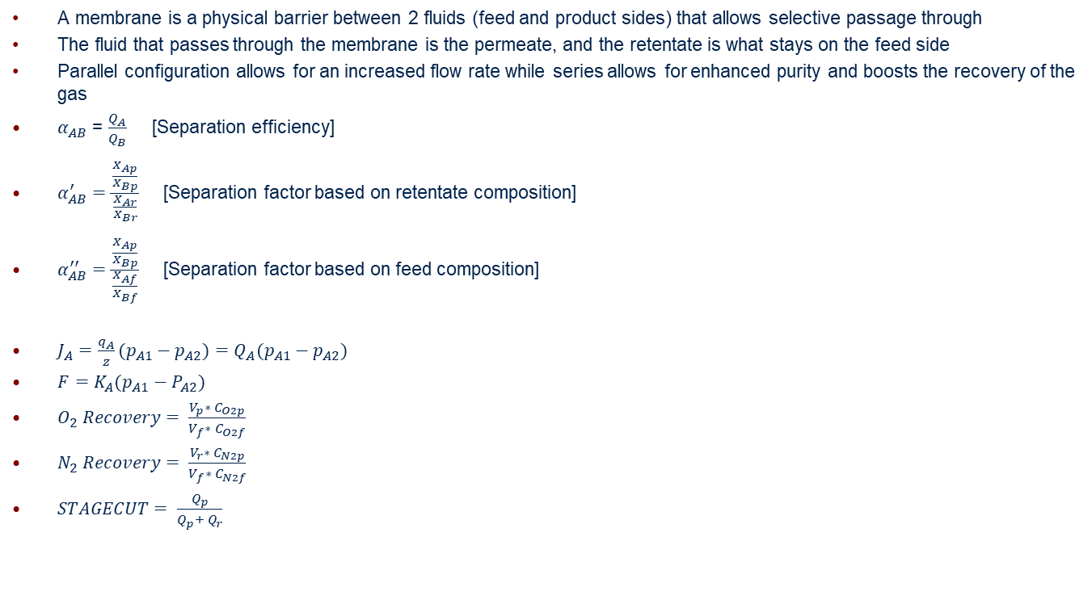
Theory
A membrane is a physical barrier between 2 fluids (feed and product sides) that allows selective passage through
The fluid that passes through the membrane is the permeate, and the retentate is what stays on the feed side
Parallel configuration allows for an increased flow rate while series allows for enhanced purity and boosts the recovery of the gas
$α_{AB}$ = $\frac{Q_{A}}{Q_{B}}$ [Separation efficiency]
$α_{AB}^{′}=\frac{\frac{X_{Ap}}{X_{Bp}}}{\frac{X_{Ar}}{X_{Br}}}$ [Separation factor based on retentate composition]
$α_{AB}^{′′}=\frac{\frac{X_{Ap}}{X_{Bp}}}{\frac{X_{Af}}{X_{Bf}}}$ [Separation factor based on feed composition]
$J_{A}=\frac{q_{A}}{z}(p_{A1}−p_{A2})=Q_{A}(p_{A1}−p_{A2})$
$F=K_{A}(p_{A1}−P_{A2})$
$O_{2} Recovery= \frac{V_{p}∗ C_{O2p}}{V_{f}∗ C_{O2f}}$
$N_{2} Recovery= \frac{V_{r}∗ C_{N2p}}{V_{f}∗ C_{N2f}}$
$STAGECUT= \frac{Q_{p}}{Q_{p}+ Q_{r}}$

Slide 4
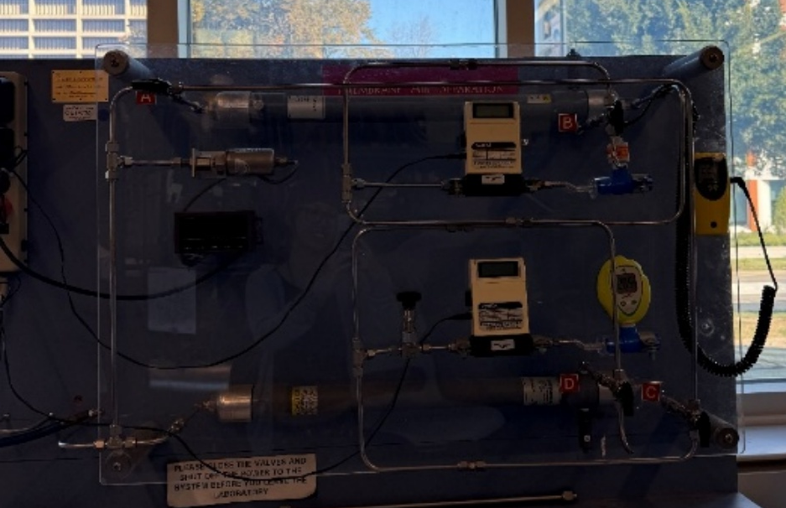
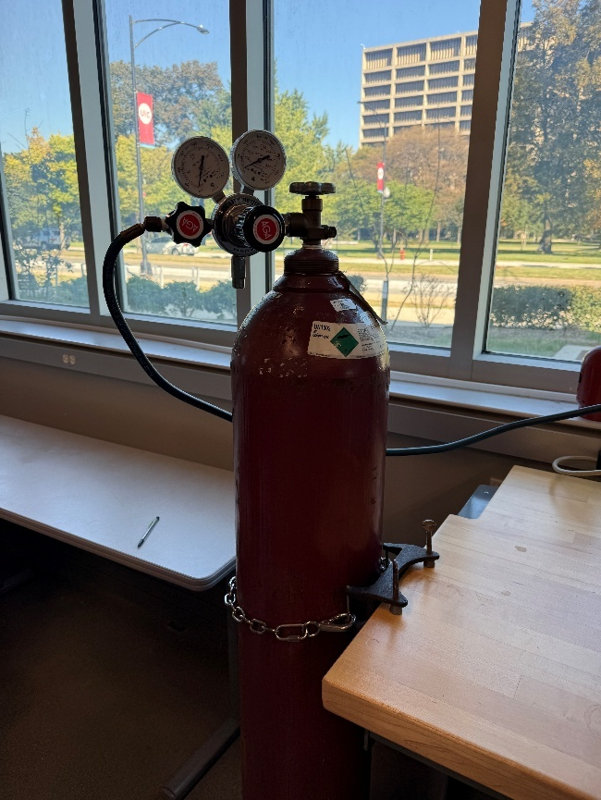
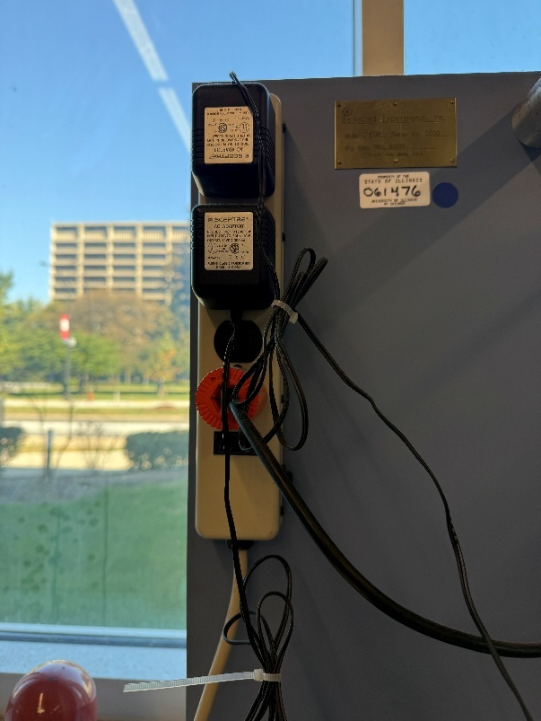
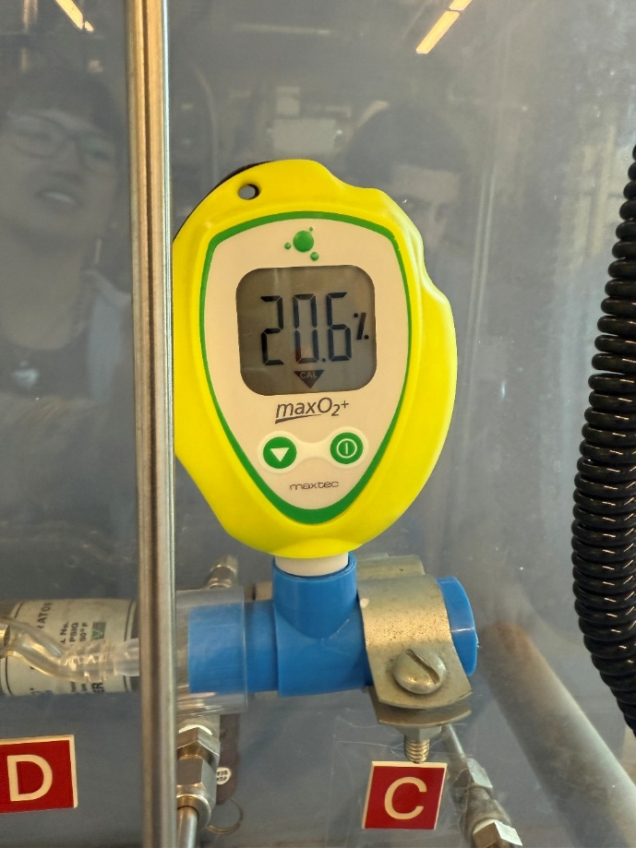
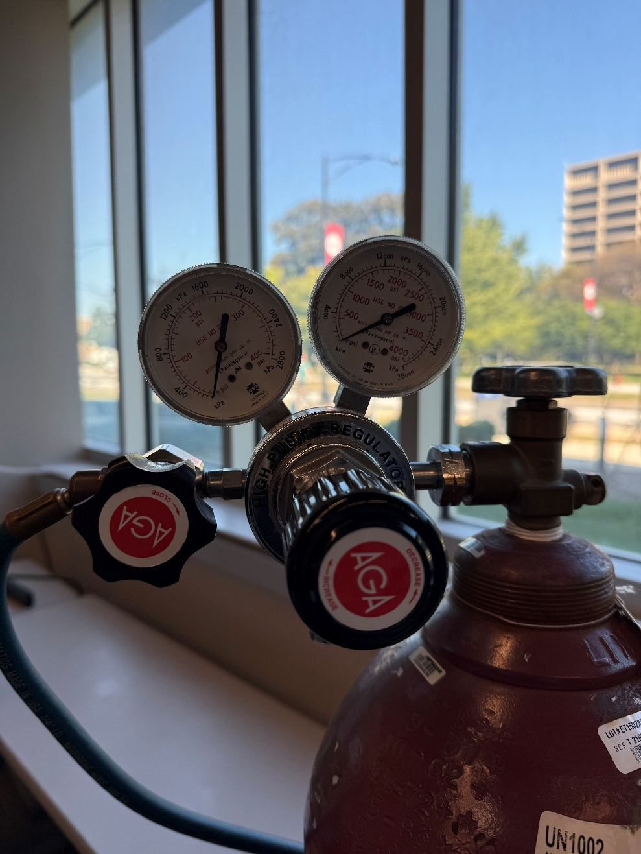
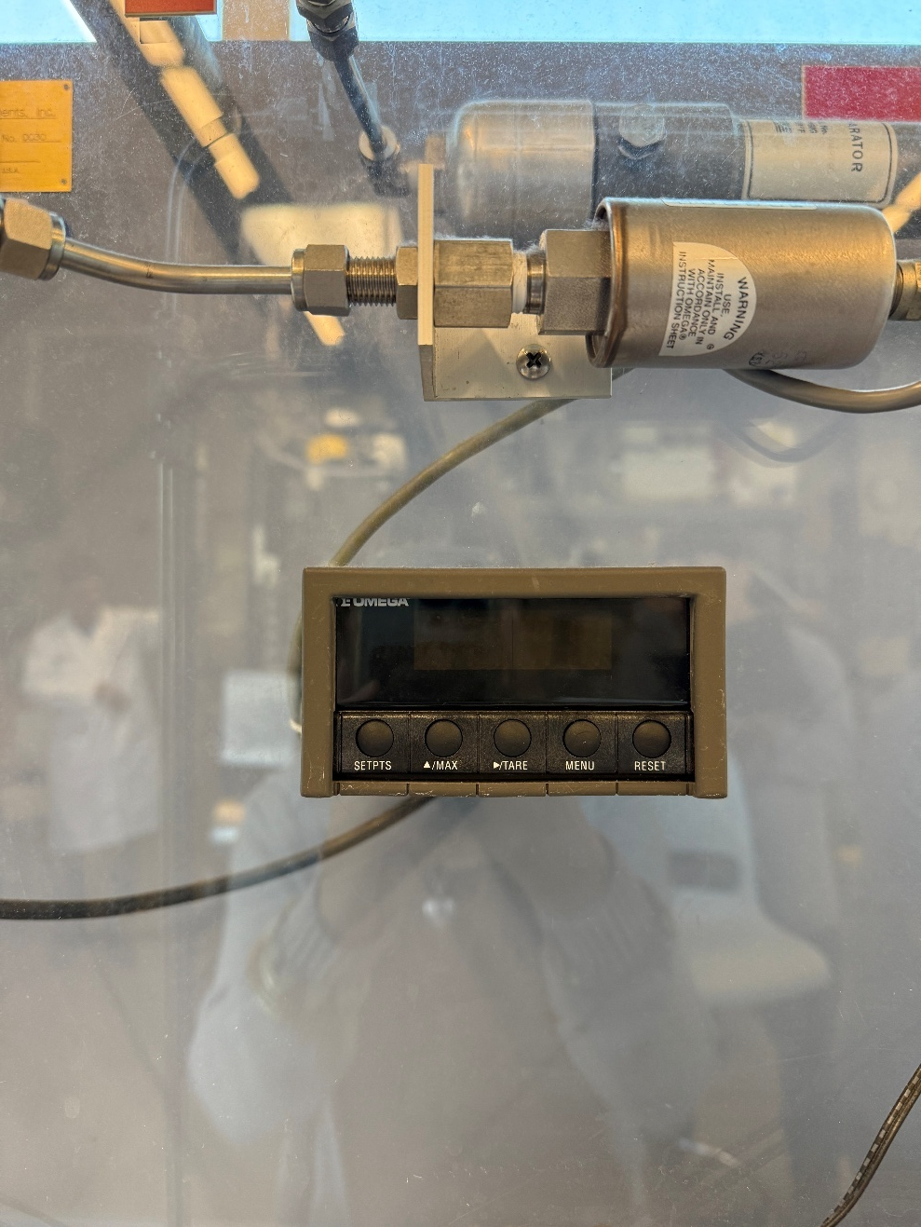
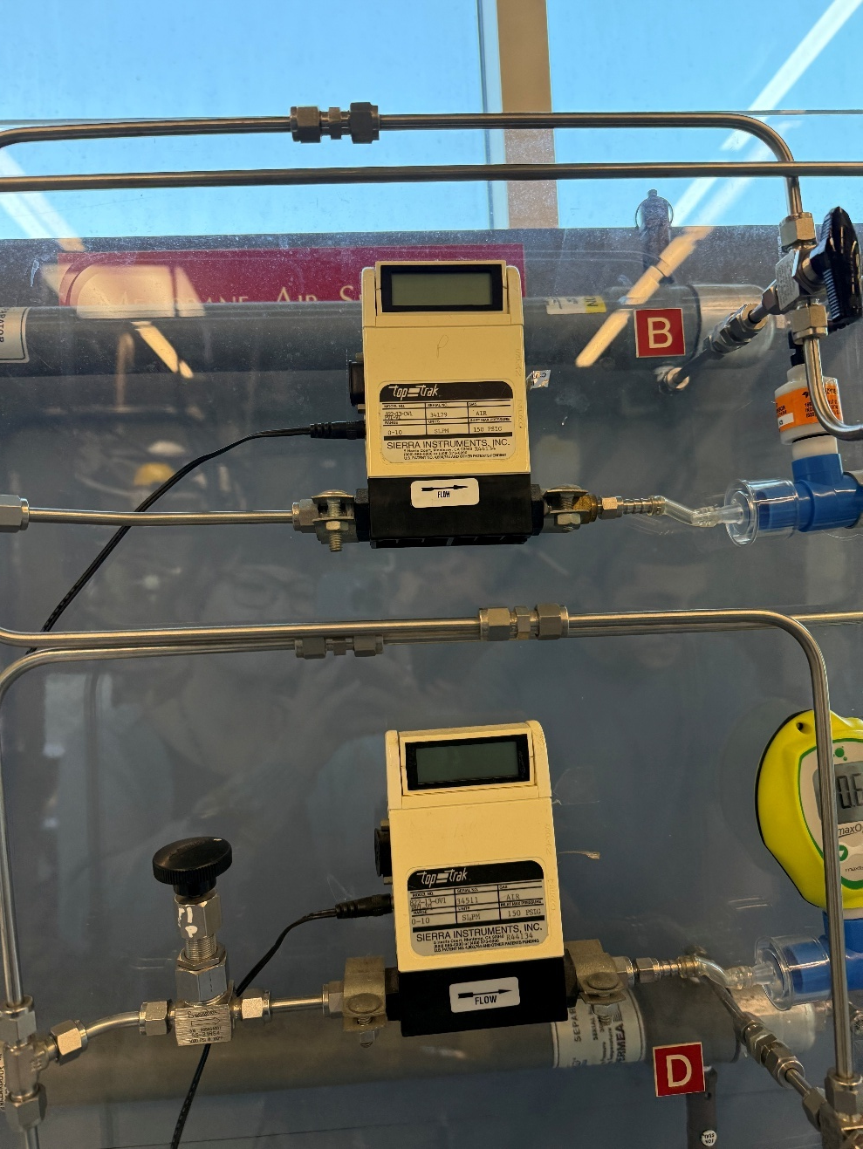
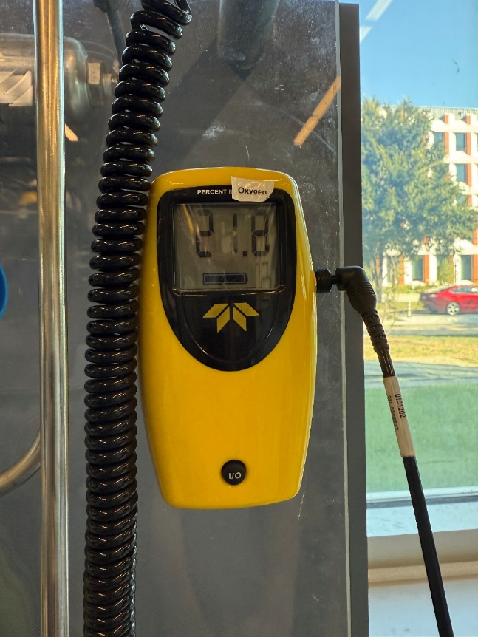
Apparatus

Slide 5
Material & Supplies
Compressed Air
Pressure gauge
O2 Sensor (2x)
Valves
Flow rate controllers (2x)
Pressure regulator and release valves
Power Source (electrical outlet)

Slide 6
Procedure
Turn on both O2 sensors, wait for 10 minutes. Calibrate to 20.9% O₂. Make sure flow meters and pressure display are on
Open the compressed air and take note of cylinder pressure. Use the regulator to set run pressures
Set up the parallel test. Series will be done after
Adjust the needle valve to the desired tube side effluent flowrate. Recheck pressure changes
Once steady, record pressure, flow rates, and O₂ %s
Around 15 runs done for parallel and series configuration each

Slide 7
Experimental Challenges
Watch out for pressure control, adjusting valves, and flow rate control during experiment
Patiently wait for readings to settle
Make sure to calibrate O2 sensor

Slide 8
Safety
High-pressure compressed air in the tank
Make sure to properly set up configurations so as not to have both valves closed
Wear PPE
Read SDS for compressed air

